Slide 1
The Business Case for Inclusive Employment
Presented by Dylan Morin & Miranda Klinger

Slide 2
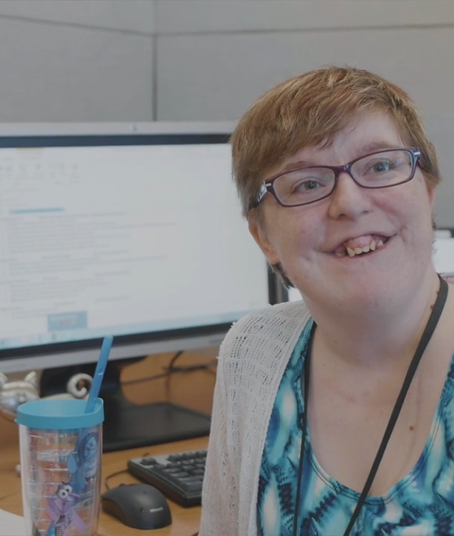
What is Inclusive Employment?
Meaningful & competitively paid positions for people with disabilities.

Slide 3

The Picture In Canada…
15.5% of Canadians have a disability
50% of the disabled are unemployed
Over 400,000 recent grads with a disability - who have NEVER worked… 270,000 of those have a POST-SECONDARY education!
Actual unemployment rate for people with disabilities is approaching 70%
Source: Statsitcs Canada, 2011

Slide 4

Why??
Many myths & misperceptions in HR and hiring practices that someone with a disability will:
Cost more money
Work less safely
Require more supervision
Be less innovative
TRUTH - Hiring inclusively brings real economic change to workplaces….

Slide 5

How?
THE EXAMPLE - MARK WAFER
Owner of 6 Tim Hortons franchises in Ontario
20 years of experience in hiring people with disabilities
Currently employs 46 people with disabilities among a workforce of 250

Slide 6

Lower Absenteeism
85% lower than those employees without a disability
Why is that?
People with a disability tend to work in a safe manor
In 20 years, and 122 people hired with disabilities, ZERO workplace injuries or claims (for those with disabilities)

Slide 7

Greater Innovation
People with disabilities have different problem solving skills.
The world looks different for a person in a wheelchair, who is blind or has an intellectual disability.
Innovation is created with unique problem solving skills & leads to a competitive edge for employers.

Slide 8

Lower Turnover
Average turnover for employees in the Quick Service Restaurant (QSR) sector is 100-125%.
Normal for a well-run business
Average turnover in Mark’s Tim Hortons is 38% AND 55% for employees without a disability - HALF THE AVERAGE OF THE QSR SECTOR.
Why is that??

Slide 9


Because…
People who do not experience life with a disability:
Want to be a part of an inclusive environment
Be involved in something special
Therefore, their turnover rate is lower as well. Workplaces experience a diverse and happier culture.

Slide 10

The Dollars & Cents
Replacing an employee can cost an employer $3000-$4000. For one individual.
Interview, uniforms, training, less productivity of a new employee vs senior employee
If you have a turnover rate of 35%, and your competitor has a turnover rate of 100%, you make more money.

Slide 11
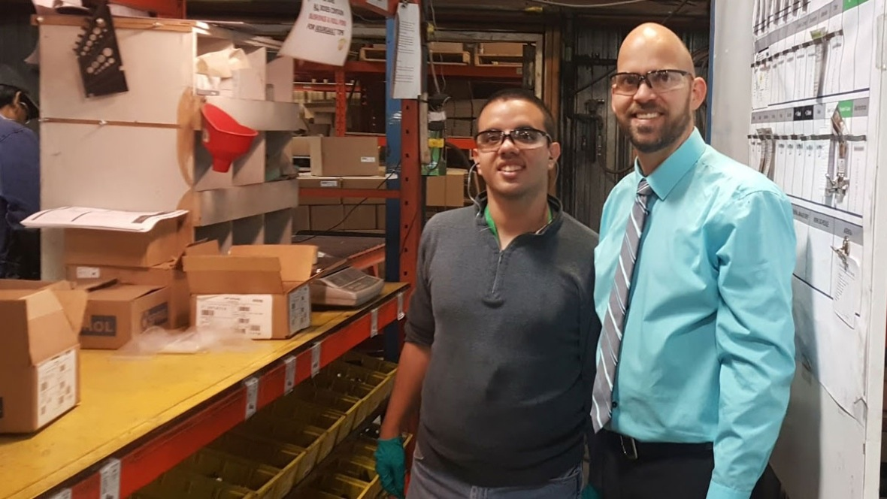
If employers can see that there’s a clear financial benefit to hiring people with disabilities because of what THEY bring to the workplace, businesses will open doors - because they just can’t afford not to!

Slide 12

Miranda Klinger
Employment Partnership Consultant

Slide 13


What is 4to40?
An initiative that connects people experiencing disability with forward thinking employers who embrace a flexible work week
Developed as a partnership between Creative Options Regina (COR) and Campus For All at the University of Regina.

Slide 14
What do we do?
Seek out, secure and maintain employment opportunities for individuals with intellectual disabilities
Establish relationships in the business community
Carve & customize roles within workplaces
Assist with hiring processes
Support job seekers once a job is secured

Slide 15





The Business Community
Steering Committee
Creating Champions
Establishing (and then maintaining) close relationships with business partners & community organizations

Slide 16

Carve & Customize
Typically not seeking out competitive application and job descriptions
Identify inefficiencies within a workplace and create a unique position tailored to the job seeker and the needs of the employer

Slide 17

Hiring Processes
Once a job description is written, we assist the employer by submitting resumes for job seekers who are interested or have skills in the area of work.
Work with job seekers to write resumes, interview skills, preparing for interview process.
Attend interviews with job seekers.
Offer insight and direction for employer and/or HR.

Slide 18
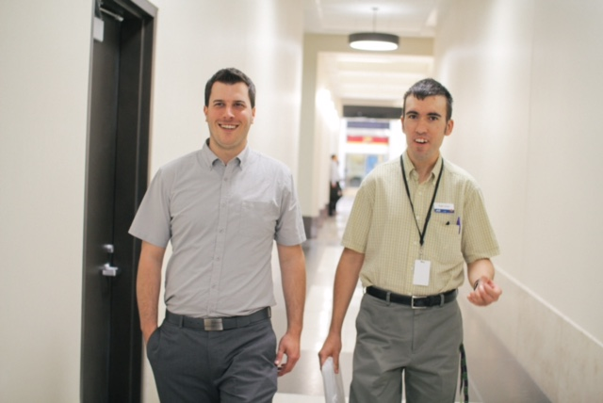

Job Coaching
Help create success
Supports both the new employee & the employer.
Provides guidance, feedback, support and re-direction.
Balances assisting with job tasks, as well as relationship building.
As the employee progresses, job coach gradually fades from the job site.

Slide 19

Success…
is about more than just doing the job well.
Part of a team
Building relationships
Valued & welcomed

Slide 20
A word from an employer…
University Of Regina - Inclusive Employers/
For more info: www.4to40.ca

